Slide 1


Interactive Lifecycle Document Development with Requirements Tracking
Naval Undersea Warfare Center Division Newport
Client: Mr. Michael Grimley
Team: Jeremiah Butler
Peter Magalhaes
Aria Ushani
Kevin Palmer
Notes:
Good morning, everyone. My name is Kevin, this is Jeremiah, Peter, and Ari. Our project was given to us by the Naval Undersea Warfare Center in Newport, RI. Our client, Mr. Grimley, requested us to create an Interactive Lifecycle Document Project Manager that incorporates Requirements Tracking.

Slide 2

Abstract
We were given a task of creating a system to maintain documents throughout the software development process.
This includes creating new documents as well tracking individual requirements throughout the lifecycle of the project
Notes:
Developers at NUWC are currently using Microsoft Word to create and edit three specific lifecycle documents: Software Requirements Doc, Use Case, and Test Case document. They are then manually tracking each requirement by database integration. There already exists systems that are able to create, track, and design documents, but these software systems tend to be expensive, complex, and require a database. NUWC wanted the system to work locally without an internet connection in Internet explorer on windows 7.

Slide 3

Problem
Using Microsoft Word to create, maintain, and manage lifecycle documents
Users manually track individual requirements for each document through various phases
Systems currently available are overly comprehensive and are typically expensive, complex, and require an underlying database
Users who may have little computer experience, or even no prior XML experience.
Notes:
Developers at NUWC are currently using Microsoft Word to create and edit three specific lifecycle documents: Software Requirements Doc, Use Case, and Test Case document. They are then manually tracking each requirement by database integration. There already exists systems that are able to create, track, and design documents, but these software systems tend to be expensive, complex, and require a database. NUWC wanted the system to work locally without an internet connection in Internet explorer on windows 7.

Slide 4

Requirements
System will allow users to develop and edit lifecycle documents storing information in XML files.
Users have the ability to view existing requirements, design elements, and test cases at any point in time.
System is able to track individual requirements throughout each document.
System shall be able to auto-generate a Requirements Traceability Matrix at any point during development.
XML instances will conform to an XML Schema designed and developed by the team.
The XML instances can then be transformed into an HTML-based interactive document, using XSLT, which is also designed and developed by the team,
Notes:
Developers at NUWC are currently using Microsoft Word to create and edit three specific lifecycle documents: Software Requirements Doc, Use Case, and Test Case document. They are then manually tracking each requirement by database integration. There already exists systems that are able to create, track, and design documents, but these software systems tend to be expensive, complex, and require a database. NUWC wanted the system to work locally without an internet connection in Internet explorer on windows 7.

Slide 5

Challenges
Learning unfamiliar programming languages
Functionality to track each requirement through various phases without the use of a database
Creating a user friendly graphical interface
Non-technical users must be unaware of the use of XML
Automatically generating a requirements traceability matrix at any time
Exporting all documents as interactive HTML files.
Must work on Windows 7 using Internet Explorer.
Notes:
* Learning new languages - getting over a learning curve. Integrating different languages together for flexible functionality
* Tracking Requirements without a database - had to find a local solution. - Generating a requirements traceability matrix
* No excessive latency in the program
* Exporting entire project as HTML or PDF

Slide 6

Solution
Create a diverse schema to validate that each XML document is well-formed
Provide multiple structured XML documents to demonstrate tracking of requirements and information
Use the XSLT processor to format the information into various formats, which present the information differently
A custom javascript editor presents the transformed document to the user, so they can read it and make changes to the documentation

Slide 7





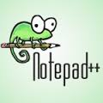
Tools
GitHub
Google Drive
Rally Software
oXygen XML
Notepad++

Slide 8

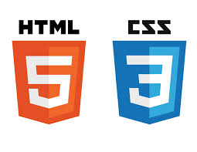

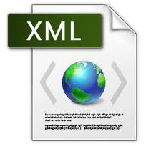
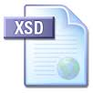
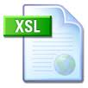
Languages
HTML
CSS
jScript
XML
XSD
XSL

Slide 9
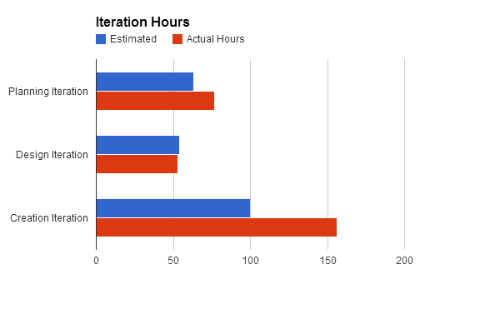
Software Process
Planning
Sept 13th through Oct 20th
Estimated - 63 hours
Actual - 76.5 hours
Design
Oct 21st through Nov 27th
Estimated - 54 hours
Actual - 53 hours
Creation
Nov 28th through April 14th
Estimated - 100 hours
Actual - 156 hours
Testing
April 14th to present
Estimated - 76 hours

Slide 10
Major Changes During Development
SCRUM Tools
Started with scrumDo which was a nice scrum tool that allowed for Google incorporation and had an iPhone app. However it lacked some necessary features such as burndown graphs so we switched to Trello, then again to RallyDev.
Koding.com
This was our original choice for cloud coding, which is a great idea for users to code simultaneously, unfortunately, Koding was in beta testing phases and caused many problems ranging from compatibility, to unavailability
HTML to HTA
Development was started using Koding which was a cloud based dev platform. After quite a bit of work, we realized that our application would operate faster without a web server. This problem was solved by converting our existing HTML code to HTA, since HTA is a windows application that runs HTML code with access to the local file system.
JS to XSLT
Originally we used javascript to create a recursive function to obtain all necessary node values. This function required a significant amount of time to complete (~20 seconds). After switching to XSLT, we were able to reduce that time to less than 1 second.

Slide 11
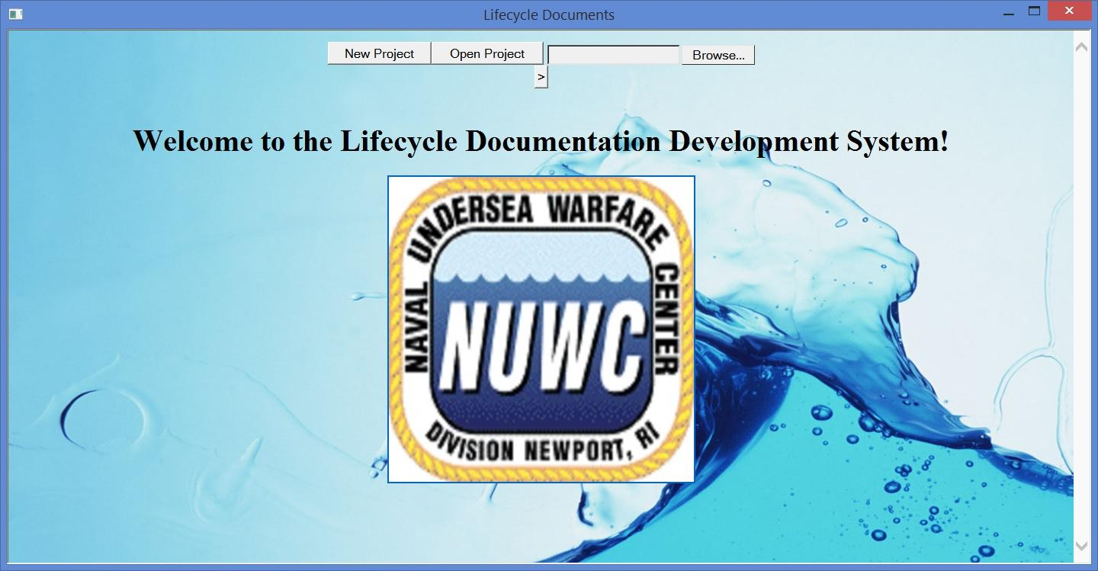
Demonstration

Slide 12



Questions?

